Slide 1

Student Name: Mohammad Abdalaziz Instructor: Engineer Motasem Samara Date: 10 – 23 – 2024, Wednesday

Slide 2
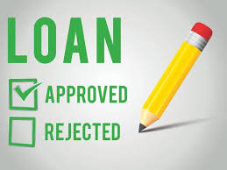

Project

Slide 3
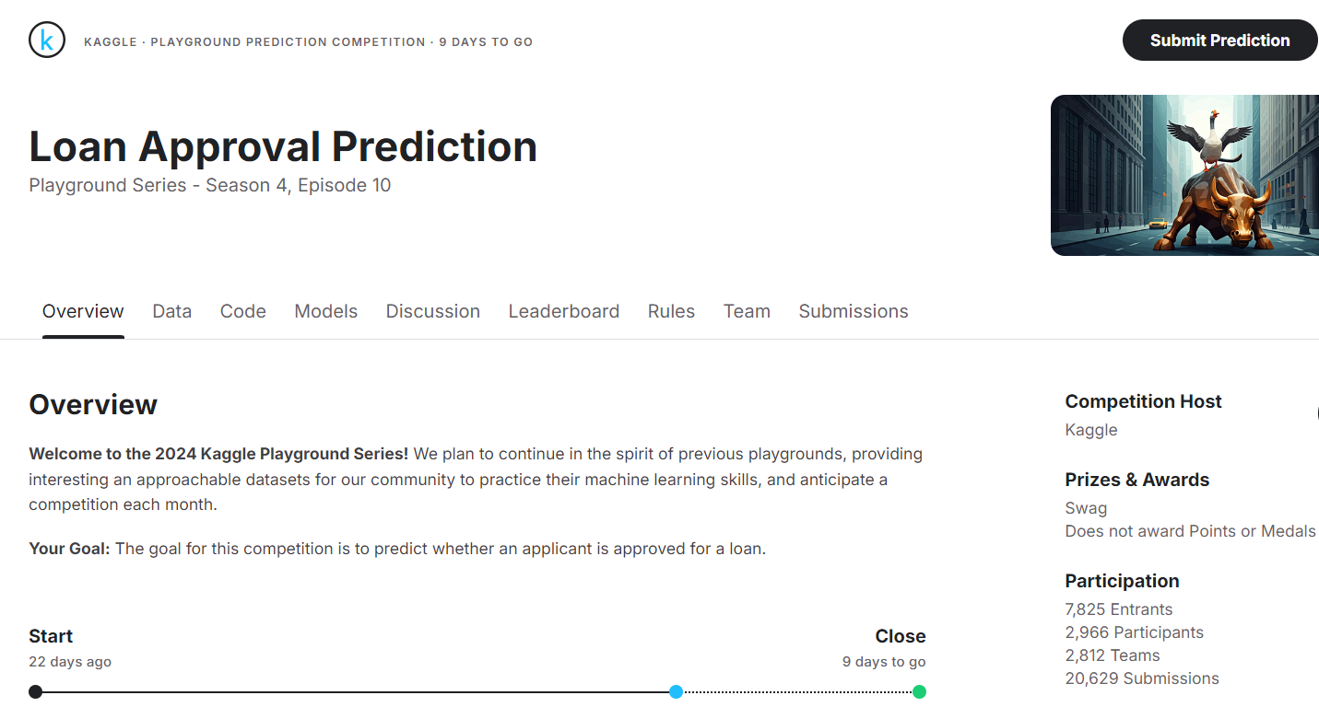
Kaggle Competition
Link → https://www.kaggle.com/competitions/playground-series-s4e10/overview

Slide 4
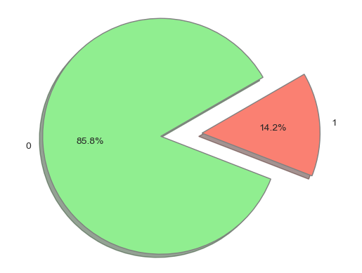
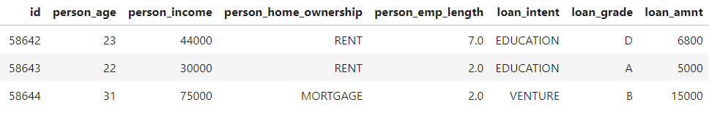
About the Data
58645 Rows, 13 Column

Slide 5
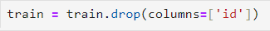
1. id

Slide 6
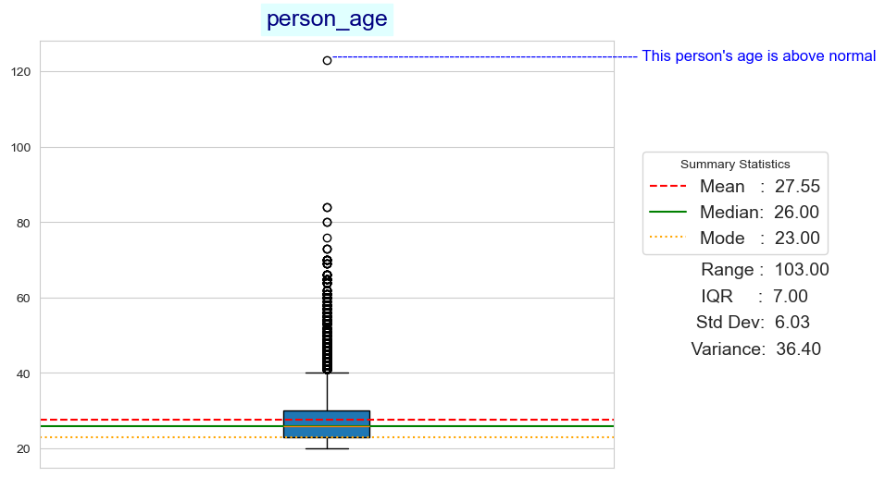
2. person_age

Slide 7
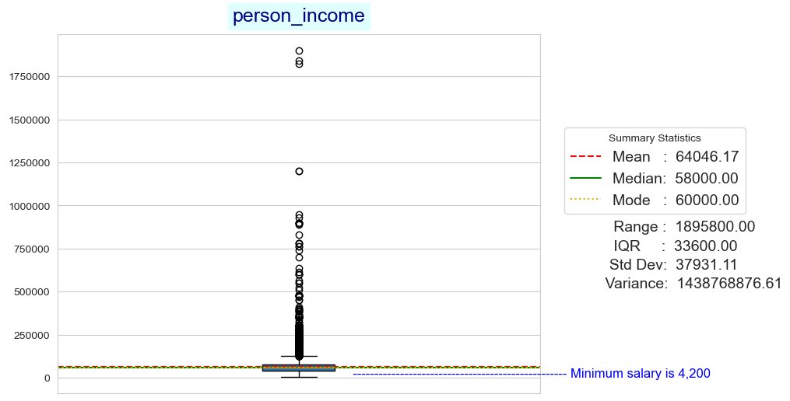
3. person_income

Slide 8
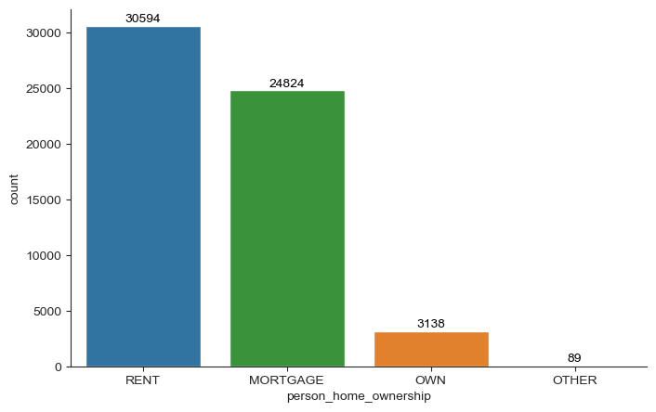
4. person_home_ownership

Slide 9
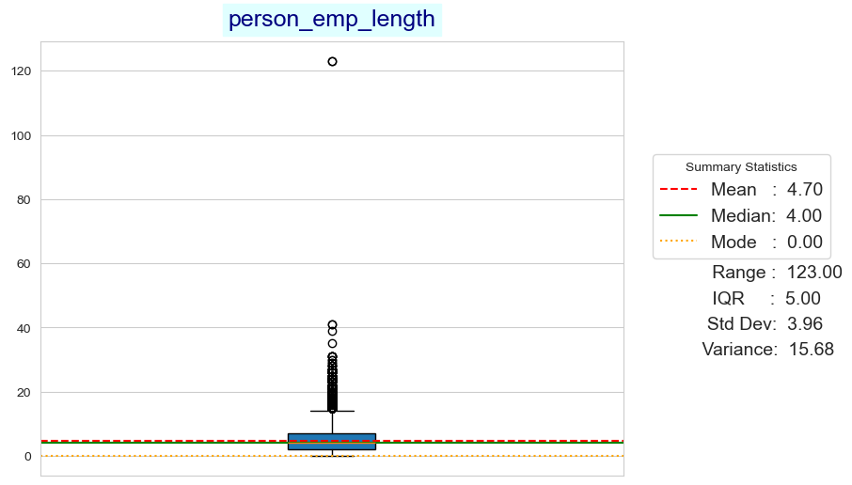
5. person_emp_length

Slide 10
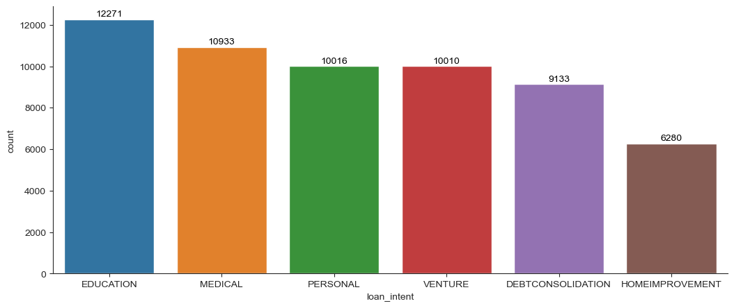
6. loan_intent

Slide 11
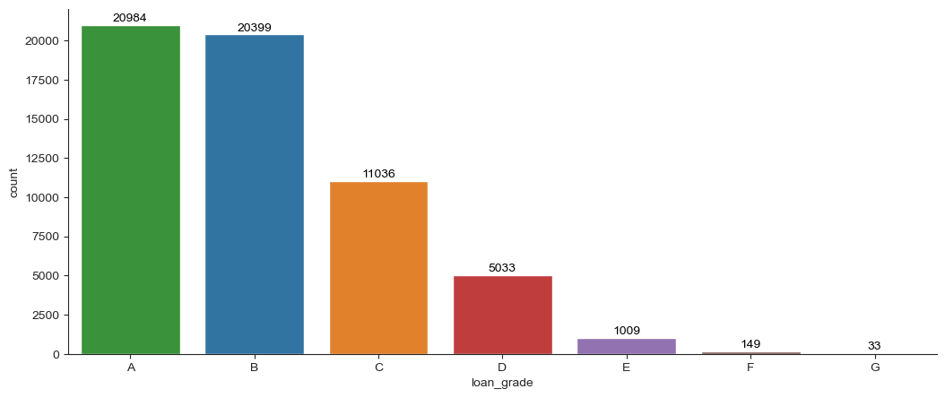
7. loan_grade

Slide 12
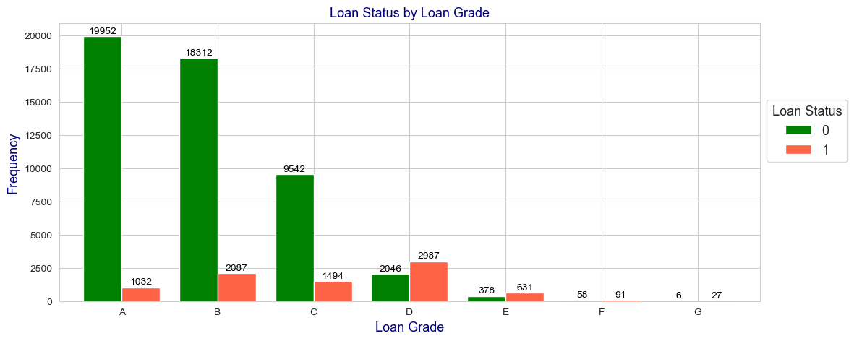

Slide 13
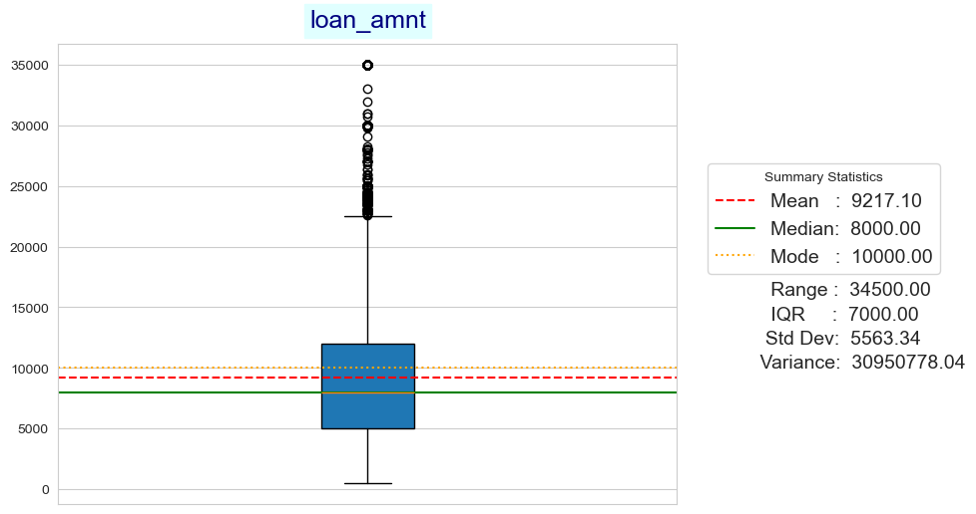
8. loan_amnt

Slide 14
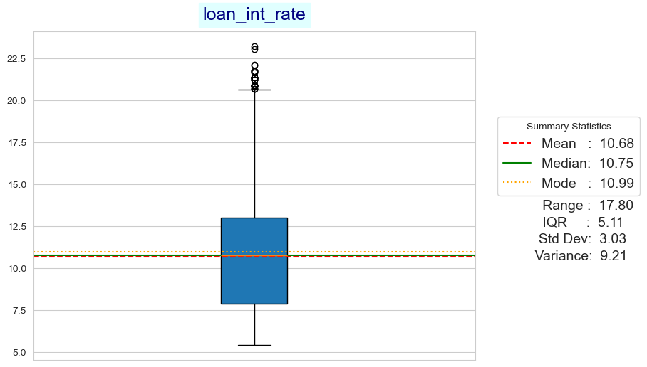
9. loan_int_rate

Slide 15
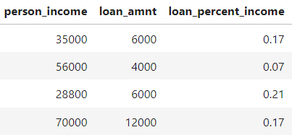
10. loan_percent_income

Slide 16
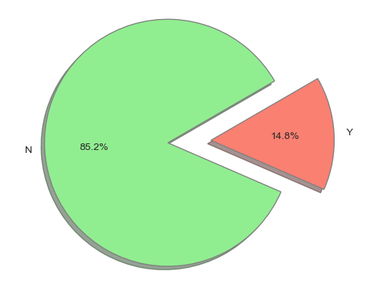
11. cb_person_default_on_file

Slide 17
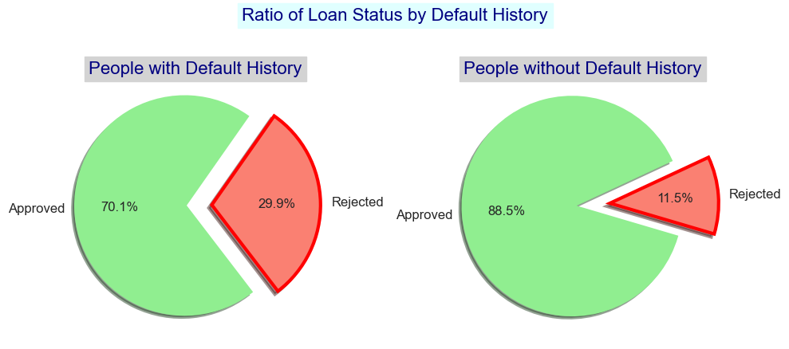

Slide 18
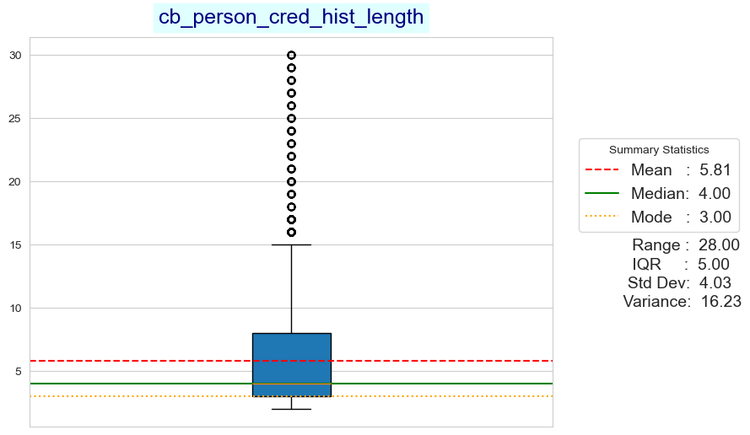
12. cb_person_cred_hist_length

Slide 19
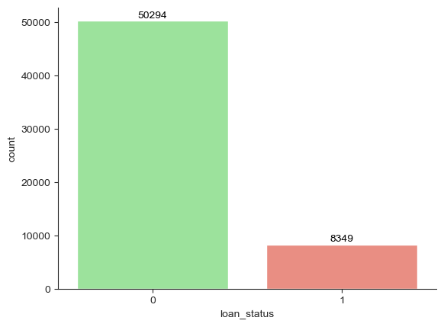
13. loan_status

Slide 20
Project Sections
Section 1: Loading the Data and Analyzing It...
Section 2: Removing Irrelevant Columns
Section 3: Providing the Necessary Plots and EDA (for each Feature)
Section 4: Splitting the Data into Training and Testing Sets
Section 5: Encoding Categorical Features
Section 6: Oversampling and Undersampling
Section 7: Feature Scaling
Section 8: Selecting the Best Encoding, Sampling, and Scaling Combination
Section 9: Model Selection
Section 10: Hyperparameter Tuning
Section 11: Model Evaluation
Section 12: PCA
Section 13: Dendogram and Agglomerative Clustering
Section 14: KMeans Clustering
Section 15: DBSCAN Clustering
Section 16: Feature Engineering and EDA
Section 17: Rebuilding the Model After Feature Engineering
Section 18: Deep Learning
Section 19: Deep Learning - Hyperparameter Tuning
Section 20: Submitting Results to Kaggle Competition
Section 21: Saving Our Model

Slide 21
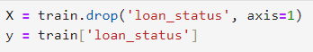
Section 4: Splitting the Data into Training and Testing Sets

Slide 22
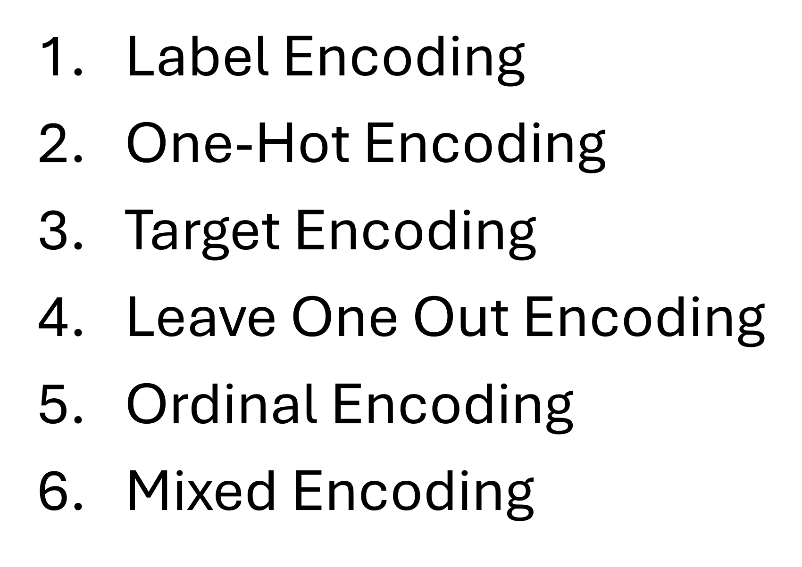
Section 5: Encoding Categorical Features

Slide 23
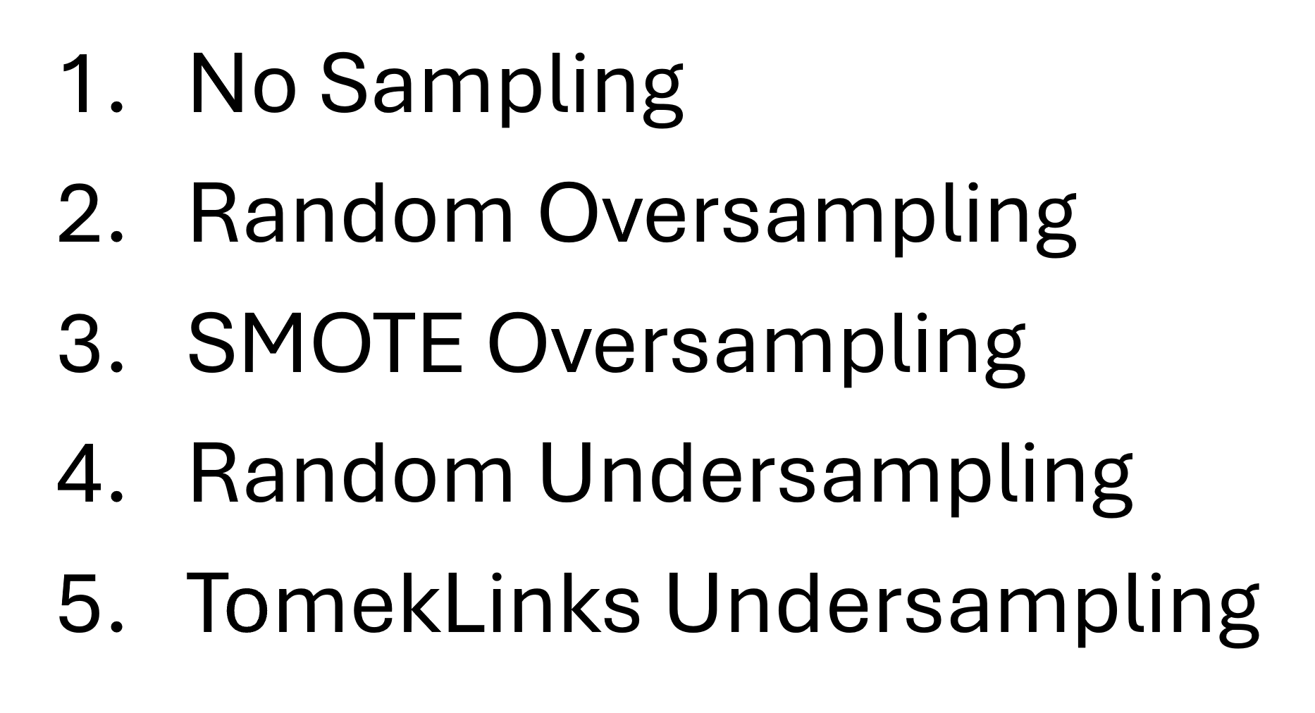
Section 6: Oversampling and Undersampling

Slide 24
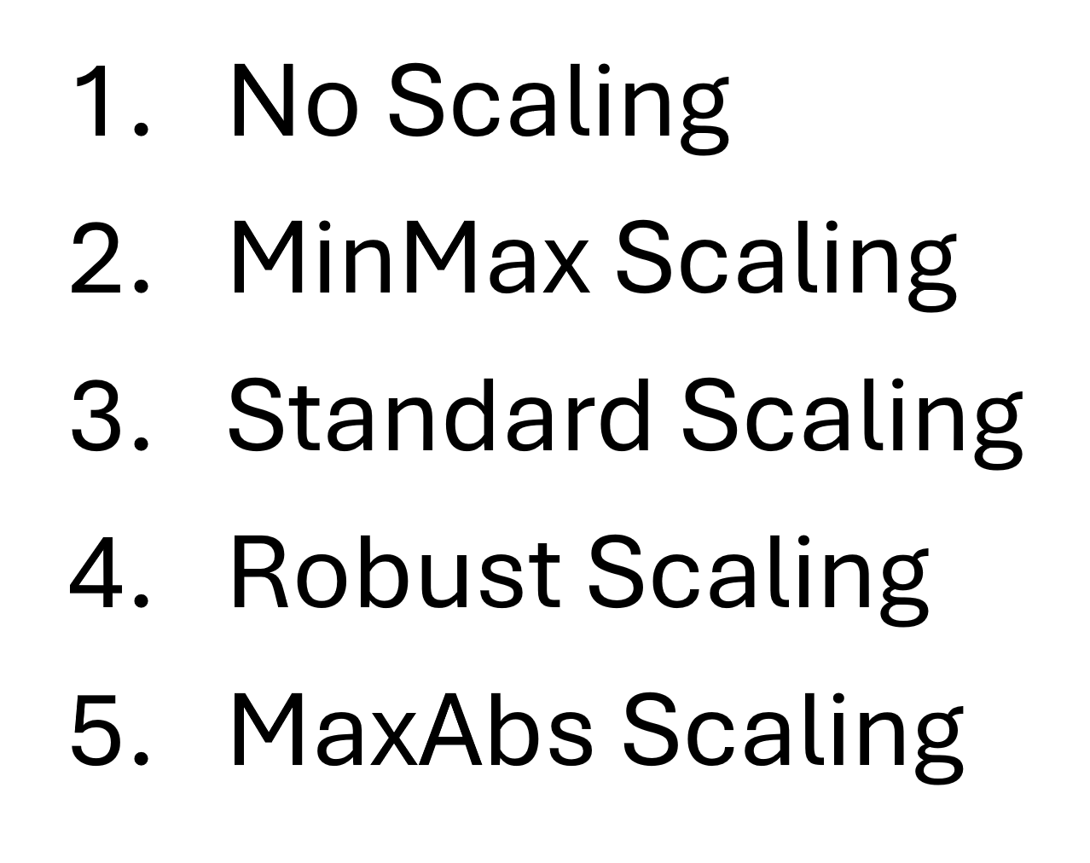
Section 7: Feature Scaling

Slide 25
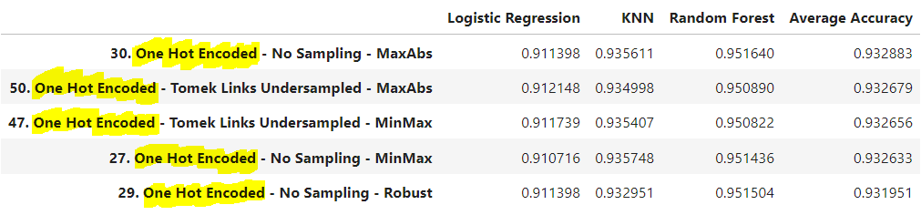

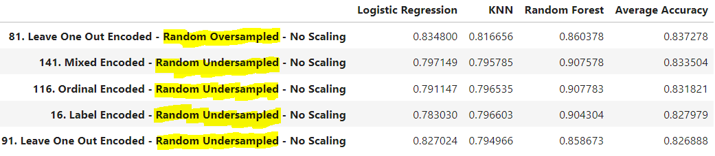
Section 8: Selecting the Best Encoding, Sampling, and Scaling Combination

Slide 26
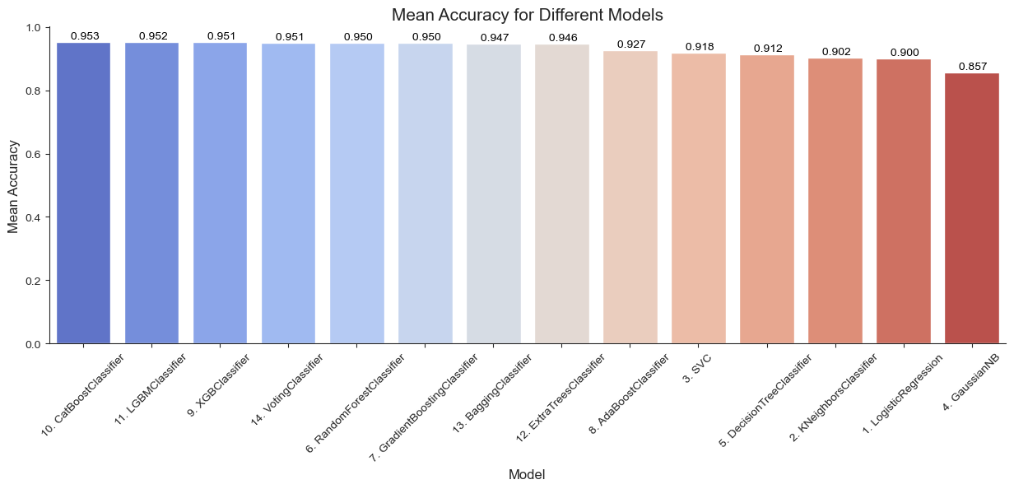
Section 9: Model Selection

Slide 27
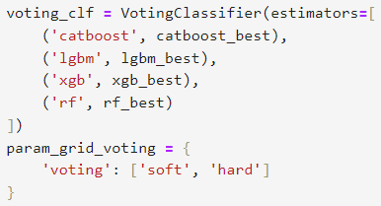
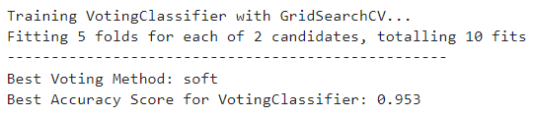
Section 10: Hyperparameter Tuning

Slide 28
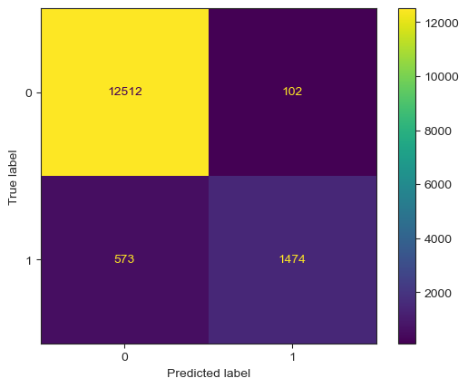
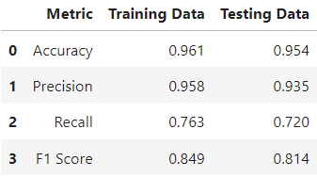
Section 11: Model Evaluation

Slide 29
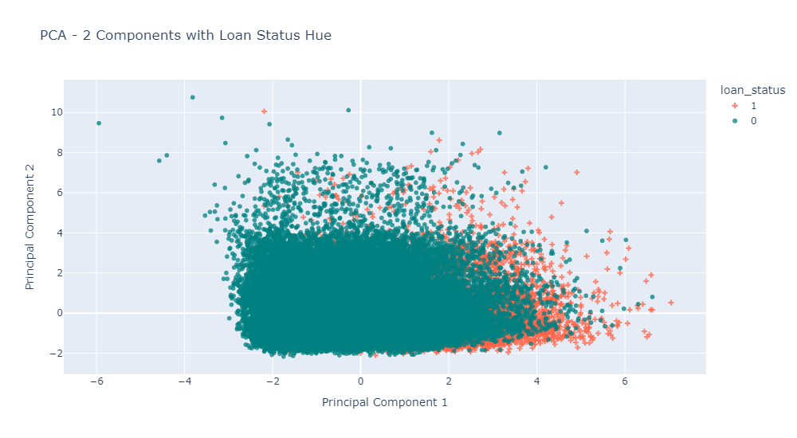
Section 12: PCA

Slide 30
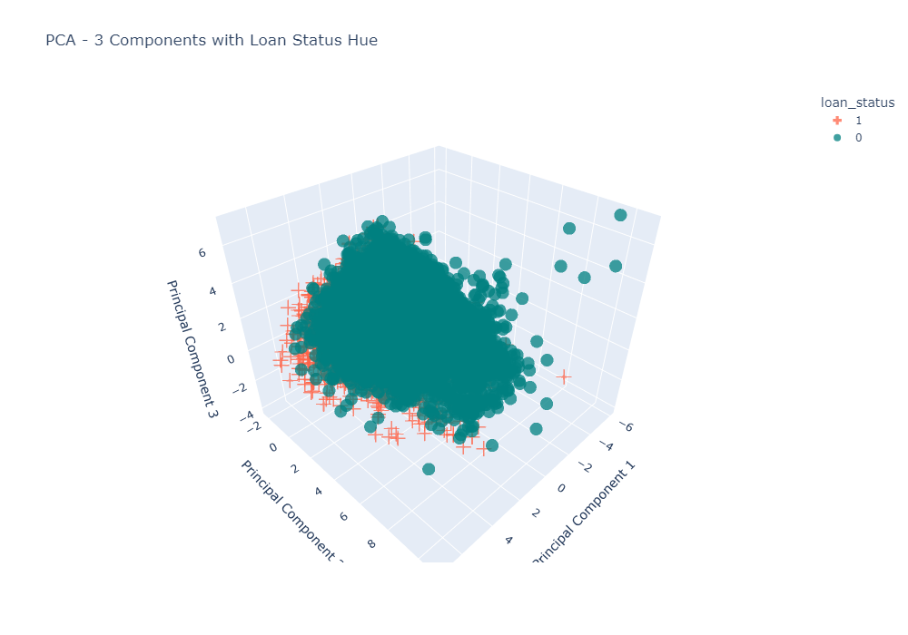

Slide 31
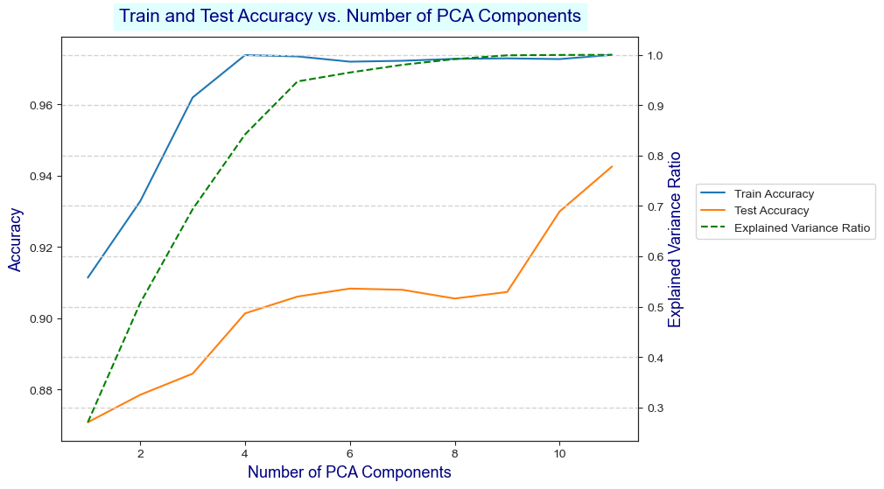

Slide 32
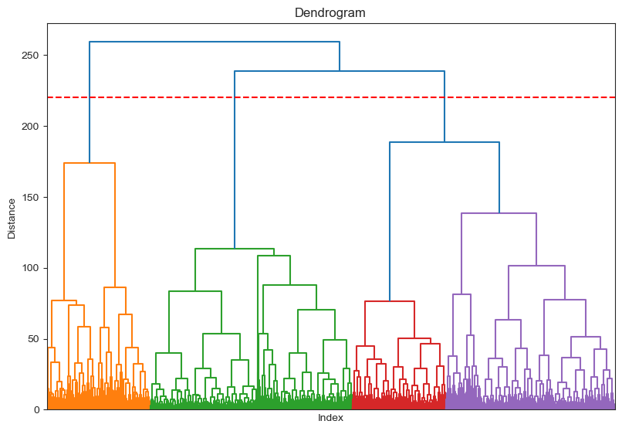
Section 13: Dendogram and Agglomerative Clustering

Slide 33
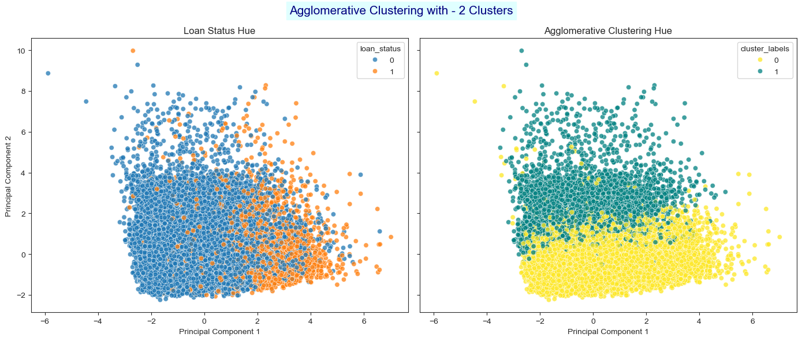

Slide 34
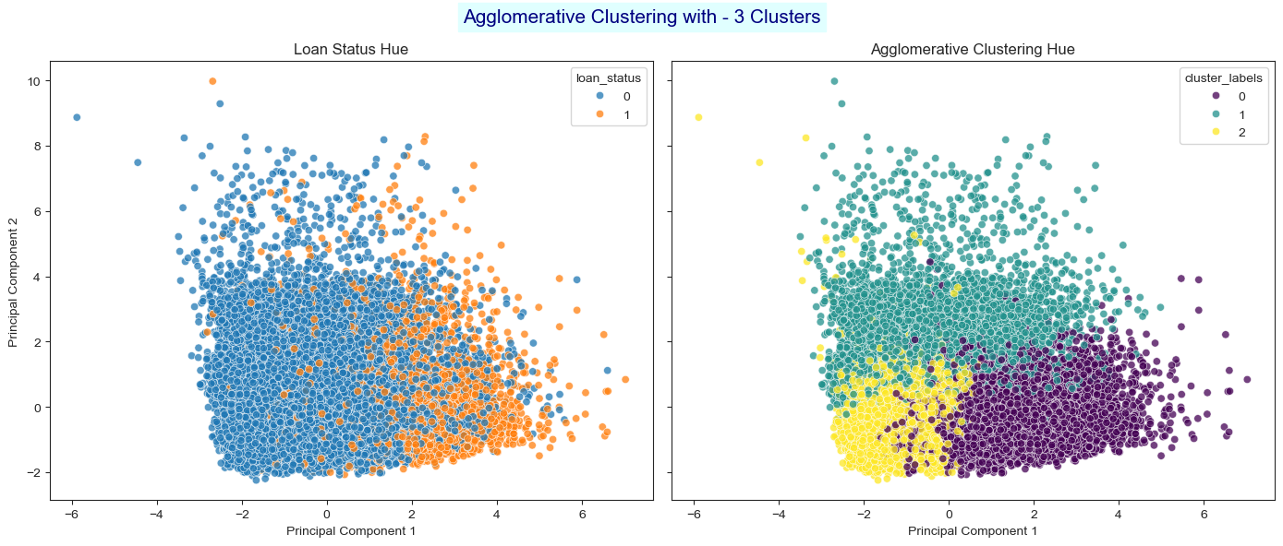

Slide 35
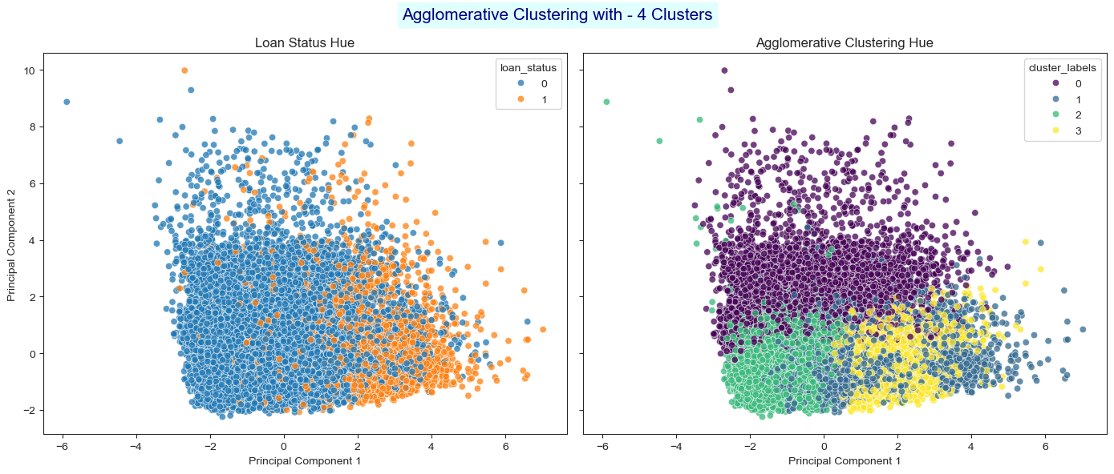

Slide 36
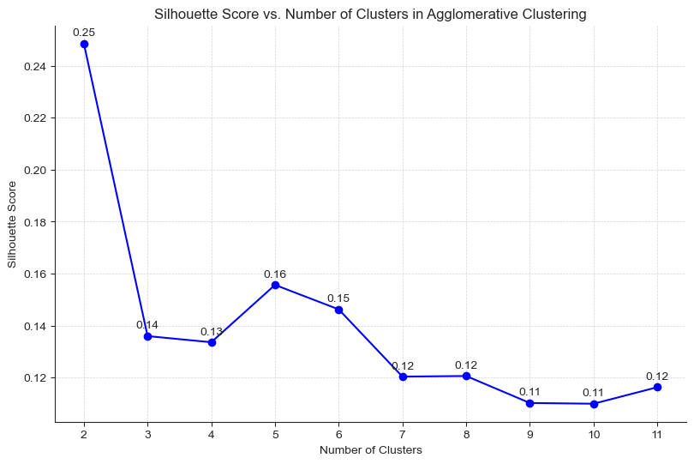

Slide 37
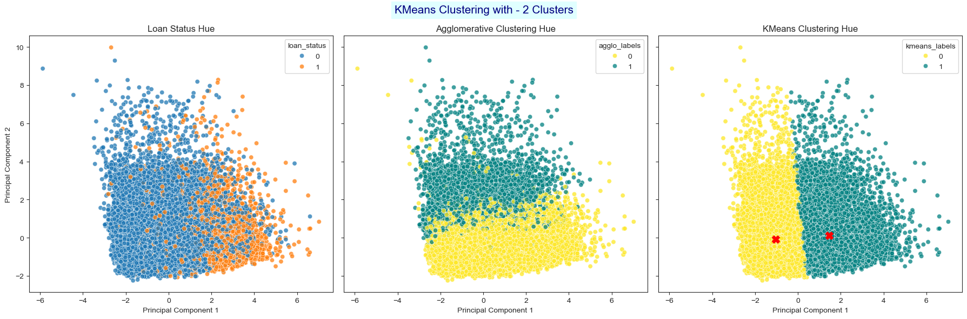
Section 14: KMeans Clustering

Slide 38
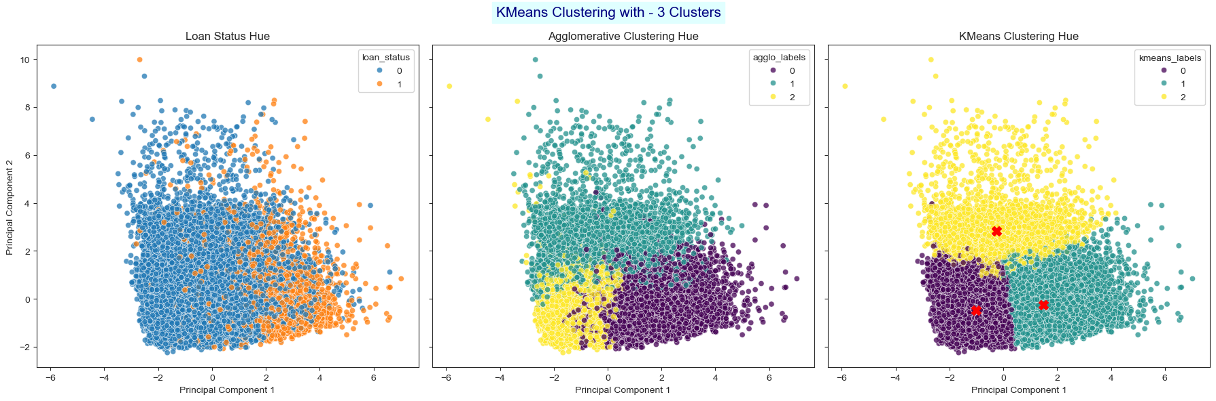

Slide 39
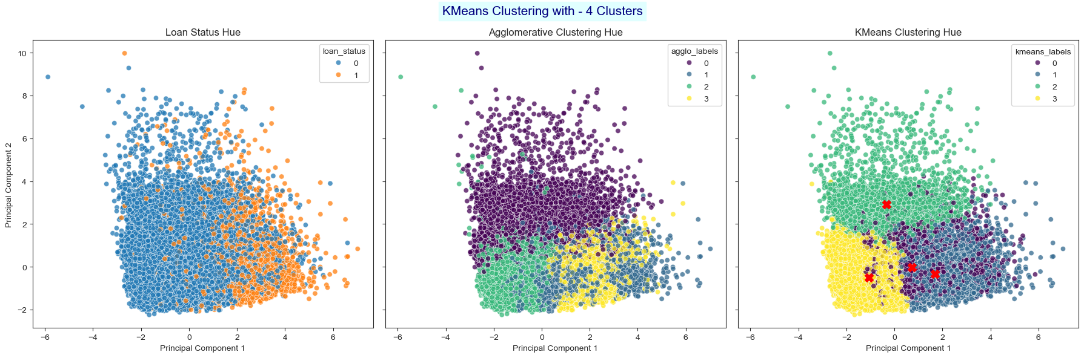

Slide 40
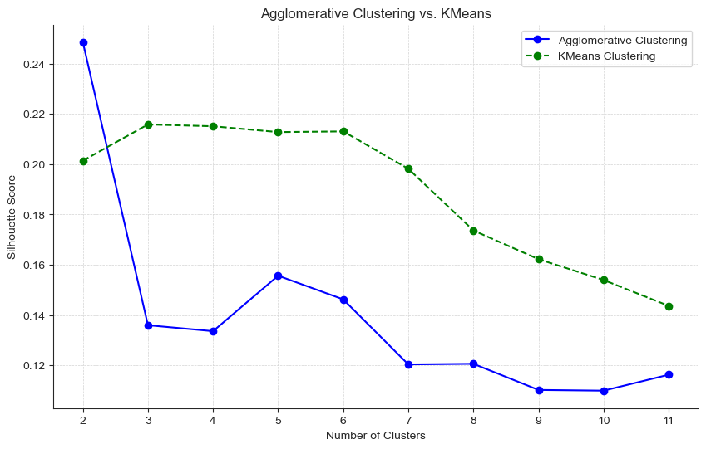

Slide 41
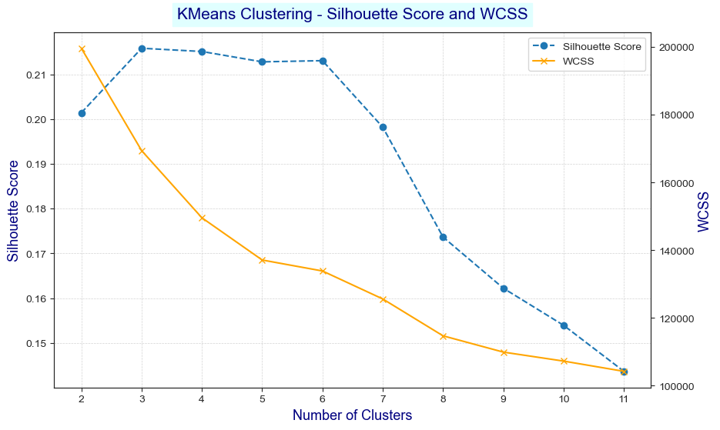

Slide 42
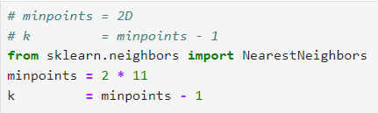
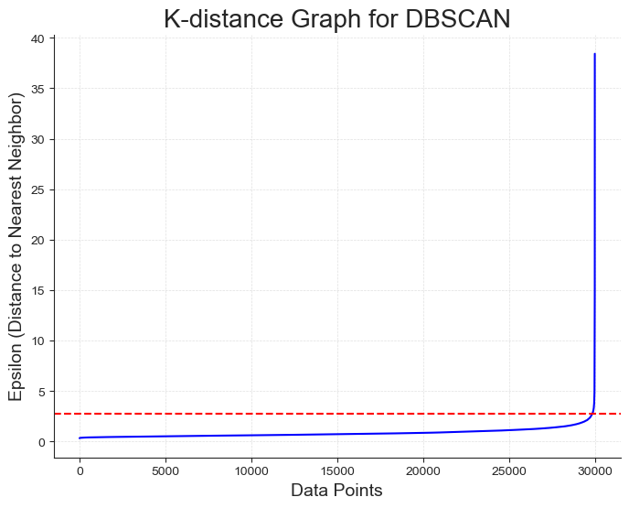
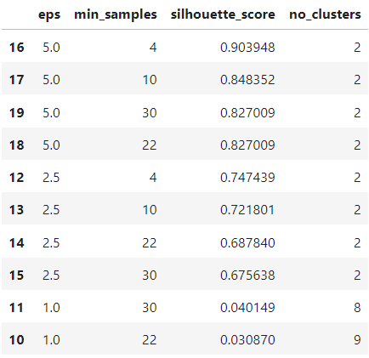
Section 15: DBSCAN Clustering

Slide 43
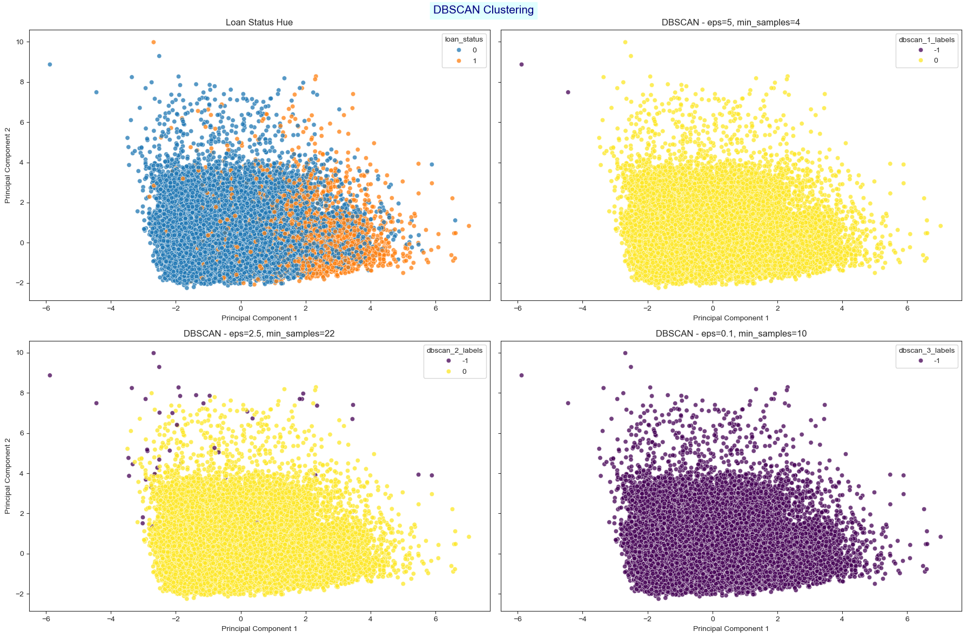

Slide 44
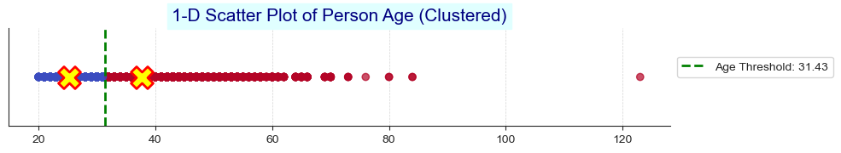
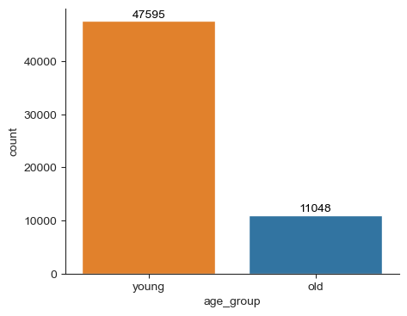
Section 16: Feature Engineering and EDA

Slide 45
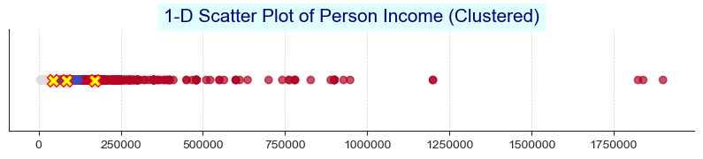



Slide 46


Slide 47

Section 17: Rebuilding the Model After Feature Engineering
Before
After

Slide 48

Section 18: Deep Learning

Slide 49


Slide 50

Section 19: Deep Learning - Hyperparameter Tuning

Slide 51

Section 20: Submitting Results to Kaggle Competition

Slide 52

Section 21: Saving Our Model

Slide 53

Streamlit

Slide 54
The End ☺

